Slide 1

Note: The data and information in this document is reflective of a hypothetical situation and client. This document is to be used for KPMG Virtual Internship purposes only.
Sprocket Central Pty Ltd
Aman Kumar Singh
Date – 26/02/2022

Slide 2
Note: The data and information in this document is reflective of a hypothetical situation and client. This document is to be used for KPMG Virtual Internship purposes only.
Agenda
Introduction
Data Exploration
Model Development
Interpretation

Slide 3
Note: The data and information in this document is reflective of a hypothetical situation and client. This document is to be used for KPMG Virtual Internship purposes only.
Introduction
Problem Statement:
Sprocket Central Pty Ltd , a medium size bikes & cycling accessories organization, has given us a new list of 1000 potential customers with their demographics and attributes. (However, these customers do not have prior transaction history with the organisation.)
Goal:
The marketing team at Sprocket Central Pty Ltd wants to analyze there 3 datasets which could help them understand customer trends and behavior which could be applied in there New Customer List to find targeted customers to optimize there resources and boost revenue.
About Dataset:
Sprocket Central Pty Ltd provided us with 3 datasets:
Customer Demographic
Customer Addresses
Transactions data
New Customer List (which is the target data)
Steps Taken:
Data Cleaning → Cleaned for better quality
Data Transformation → Merged the transactions, customer demographic, customer address
Data Exploration → Explore the data to reveal insights

Slide 4
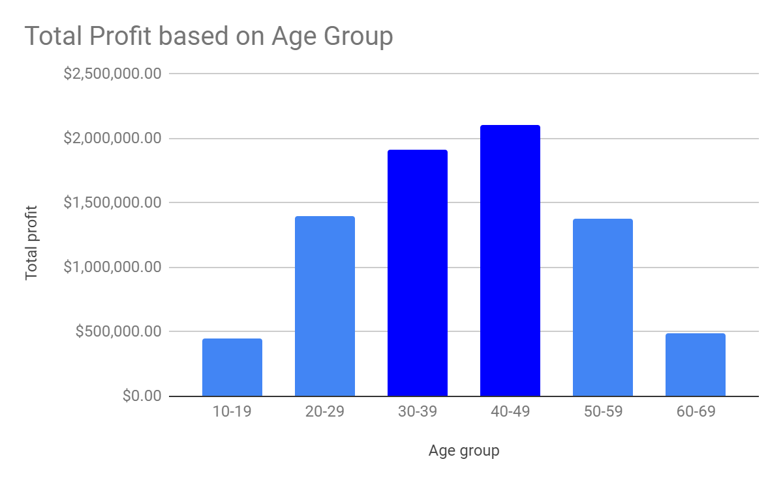
Note: The data and information in this document is reflective of a hypothetical situation and client. This document is to be used for KPMG Virtual Internship purposes only.
Data Exploration
Total Profit based on different Age Groups
Insights:
The customers between 30 to 49 age are the most profitable in terms of recent transaction history with more than 19 lacs profit.

Slide 5
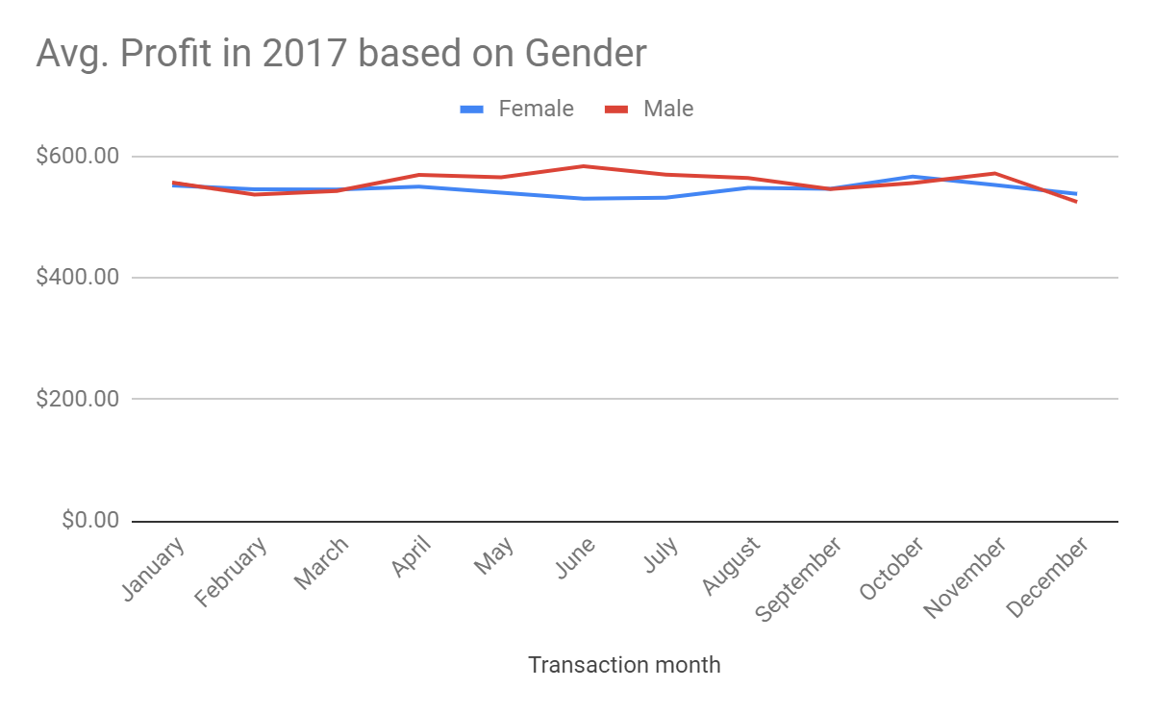
Note: The data and information in this document is reflective of a hypothetical situation and client. This document is to be used for KPMG Virtual Internship purposes only.
Data Exploration
Average Profit in the year 2017 by Gender
Insights:
Male customers are more profitable in the between the mid year i.e. April - July while female customers are showing sligh peak around october.

Slide 6
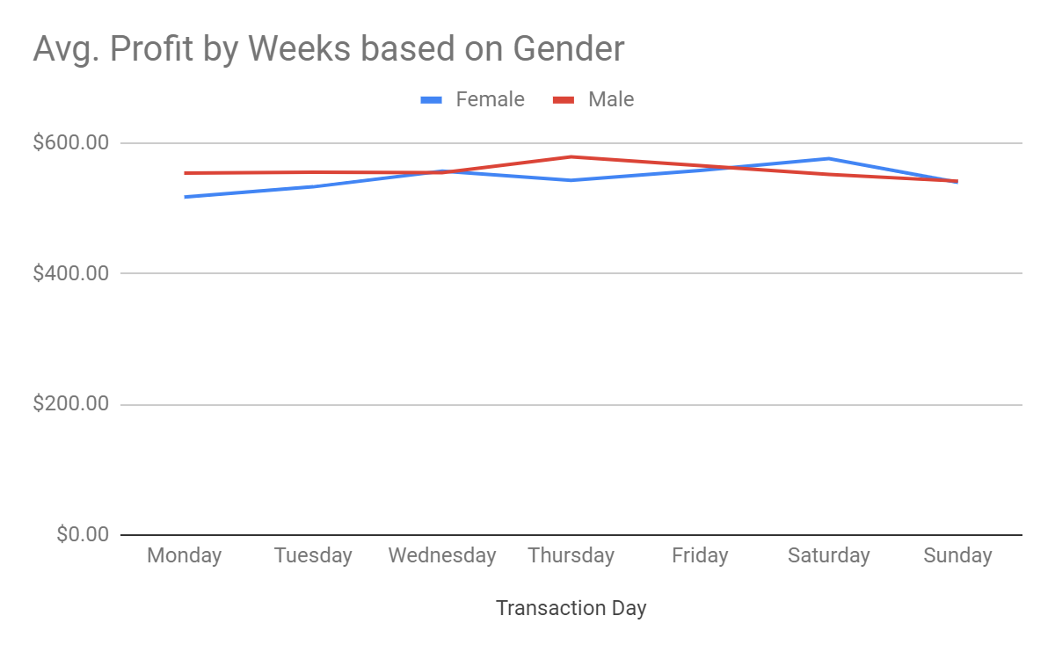
Note: The data and information in this document is reflective of a hypothetical situation and client. This document is to be used for KPMG Virtual Internship purposes only.
Data Exploration
Average Profit by Week based on Gender
Insights:
Male customers do more transactions in mid-week i.e. around thursday while female customers are showing more profit during Saturday.

Slide 7
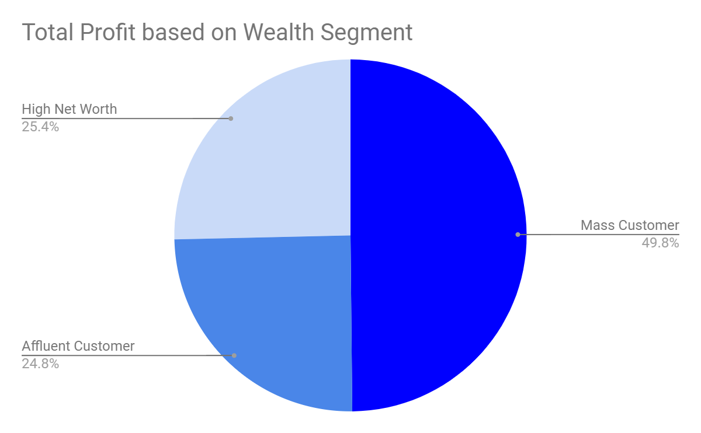
Note: The data and information in this document is reflective of a hypothetical situation and client. This document is to be used for KPMG Virtual Internship purposes only.
Data Exploration
Total Profit based on Wealth Segment of customers
Insights:
The mass customer are the most profitable segment among the three segments as nearly 50% of the profit is made by this segment.

Slide 8
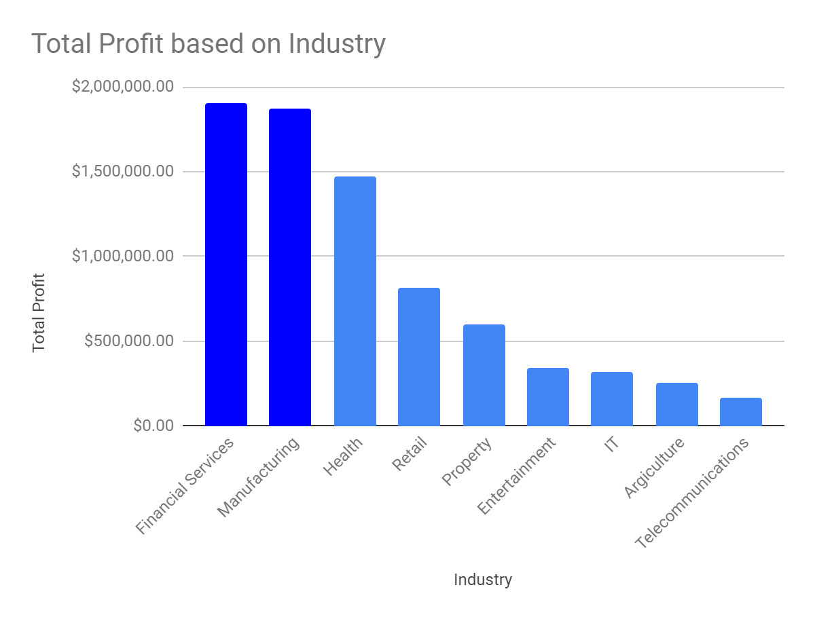
Note: The data and information in this document is reflective of a hypothetical situation and client. This document is to be used for KPMG Virtual Internship purposes only.
Data Exploration
Total Profit based on customers Industry
Insights:
The customers related to Financial Service and Manufacturing showing most profit with 18 lacs + profit.

Slide 9
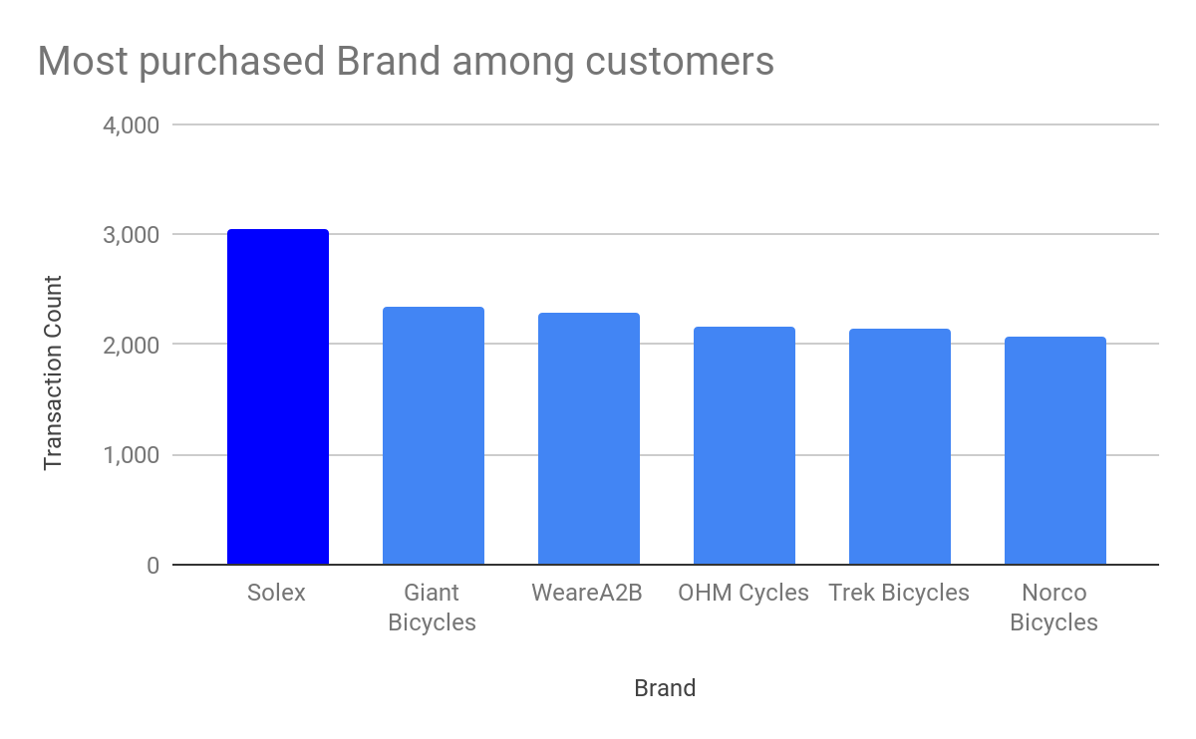
Note: The data and information in this document is reflective of a hypothetical situation and client. This document is to be used for KPMG Virtual Internship purposes only.
Data Exploration
Most purchased brands among customers
Insights:
Customers buys more Solex brand among the other brands with transaction count of more than 3000.

Slide 10
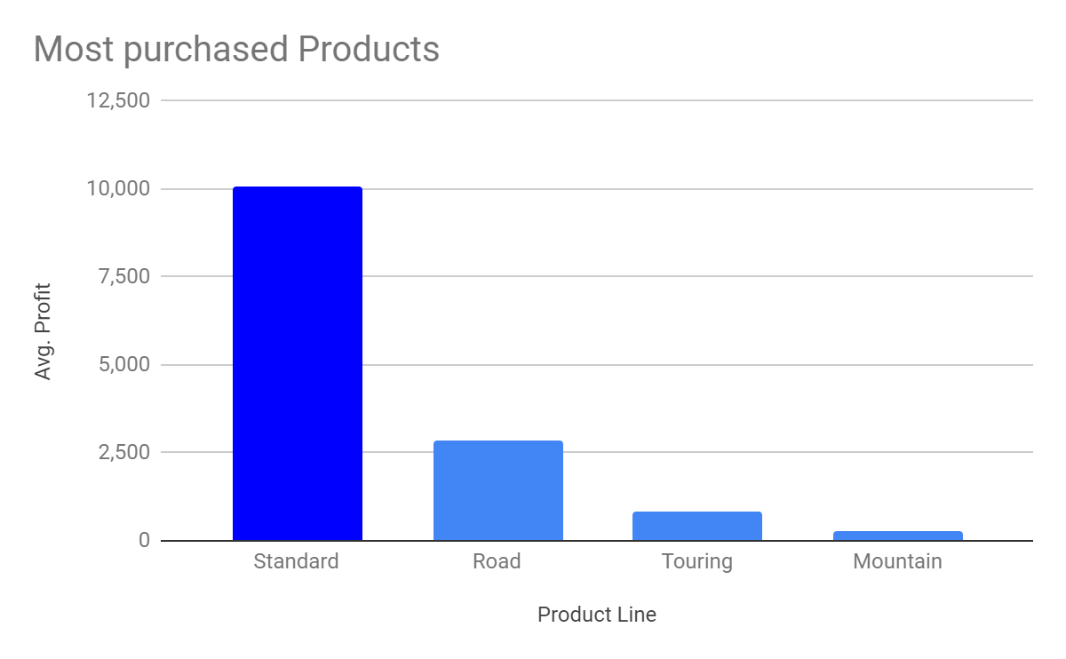
Note: The data and information in this document is reflective of a hypothetical situation and client. This document is to be used for KPMG Virtual Internship purposes only.
Data Exploration
Most purchased products among customers
Insights:
Standard product are most buyable products by customers among the other product with more than 10000 + transactions took place

Slide 11
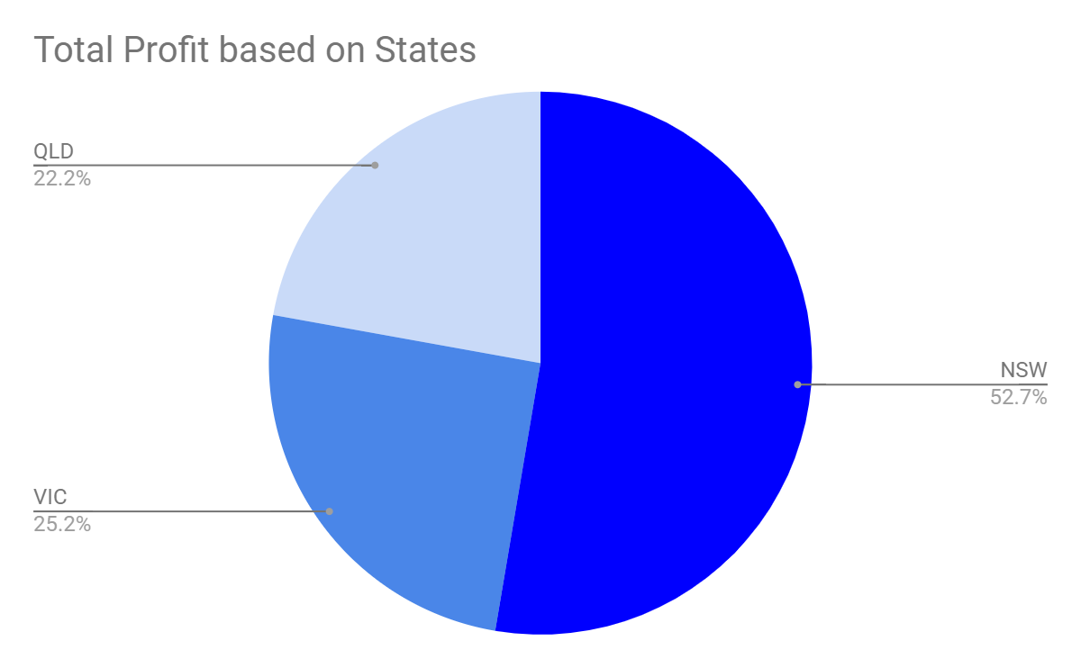
Note: The data and information in this document is reflective of a hypothetical situation and client. This document is to be used for KPMG Virtual Internship purposes only.
Data Exploration
Total Profit based on States in Australia
Insights:
Customers living in New South wales are the most profitable customers with more than 50% profit among the other States.

Slide 12
Note: The data and information in this document is reflective of a hypothetical situation and client. This document is to be used for KPMG Virtual Internship purposes only.
Model Development
Marketing team should deploy the targeted model based on -
Customer between age 30 to 49.
Male customers in the mid-year between April - July and in midweek around Thursday.
Female customers around october and in the start of the weekend, Saturday.
Customers in the Mass Consumer Segment.
Customers related to Financial Services and Manufacturing Industries.
Solex brand and Standard product as the top priority.
Customers living in New South Wales.

Slide 13
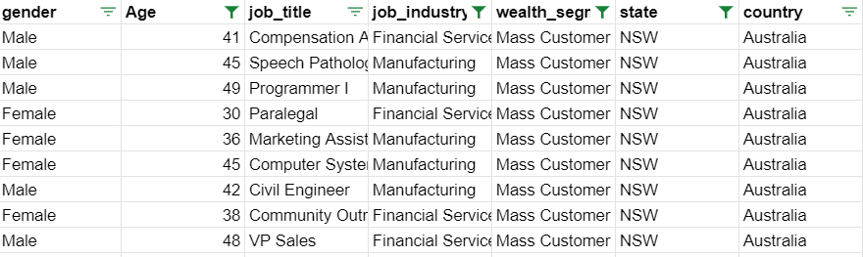
Note: The data and information in this document is reflective of a hypothetical situation and client. This document is to be used for KPMG Virtual Internship purposes only.
Interpretation
After filtering the targeted customers from the New Customer List, it will look like below

Slide 14
Note: The data and information in this document is reflective of a hypothetical situation and client. This document is to be used for KPMG Virtual Internship purposes only.
Appendix

Slide 15
Note: The data and information in this document is reflective of a hypothetical situation and client. This document is to be used for KPMG Virtual Internship purposes only.
Appendix
You can check the cleaned data here https://tinyurl.com/kscpaj49
Thank You

